Slide 1



ANALOG PID CONTROLLER
For
DC Motor Speed Regulation
DC Motor Speed Control, Transient Optimization & Tuning in OrCAD/PSpice 9.2
Department of Electrical and Electronic Engineering (EEE)
Bangladesh University of Engineering and Technology (BUET)
Presented By:
• Shafat Iqbal (Student ID: 2306025)
• Maruf Raihan (Student ID: 2306026)

Slide 2
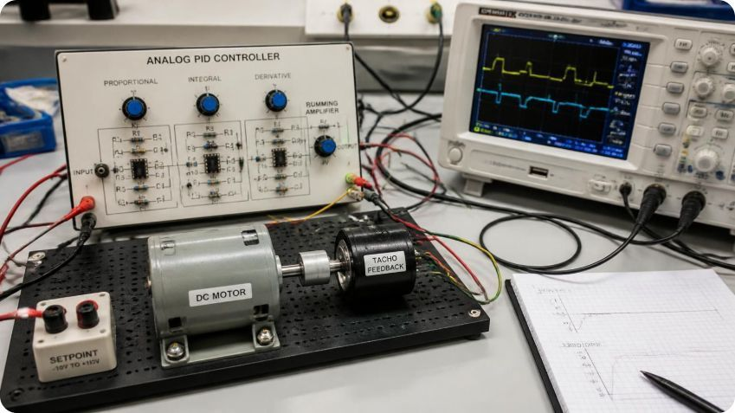
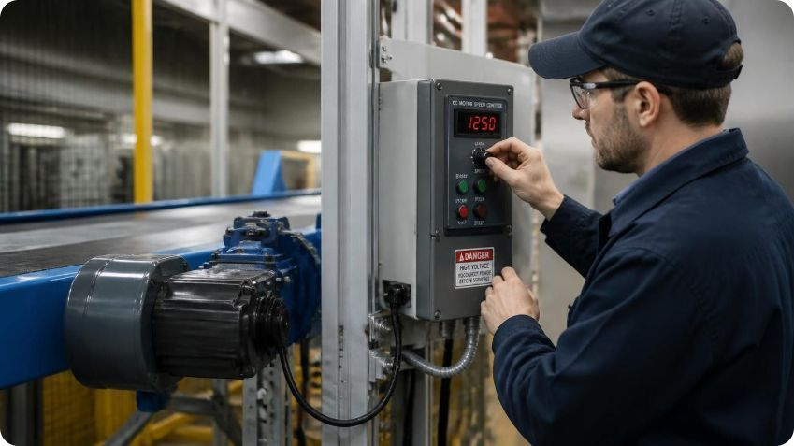


INTRODUCTION & MOTIVATION
Why precise motor speed control matters
DC motors power systems where speed stability affects performance, safety, and product quality.
The challenge
Load changes and motor back-EMF can cause speed droop, while aggressive correction can create overshoot and oscillation.
Our motivation
Design and validate an analog PID controller that delivers fast, stable, accurate speed regulation using measurable performance targets.

Slide 3
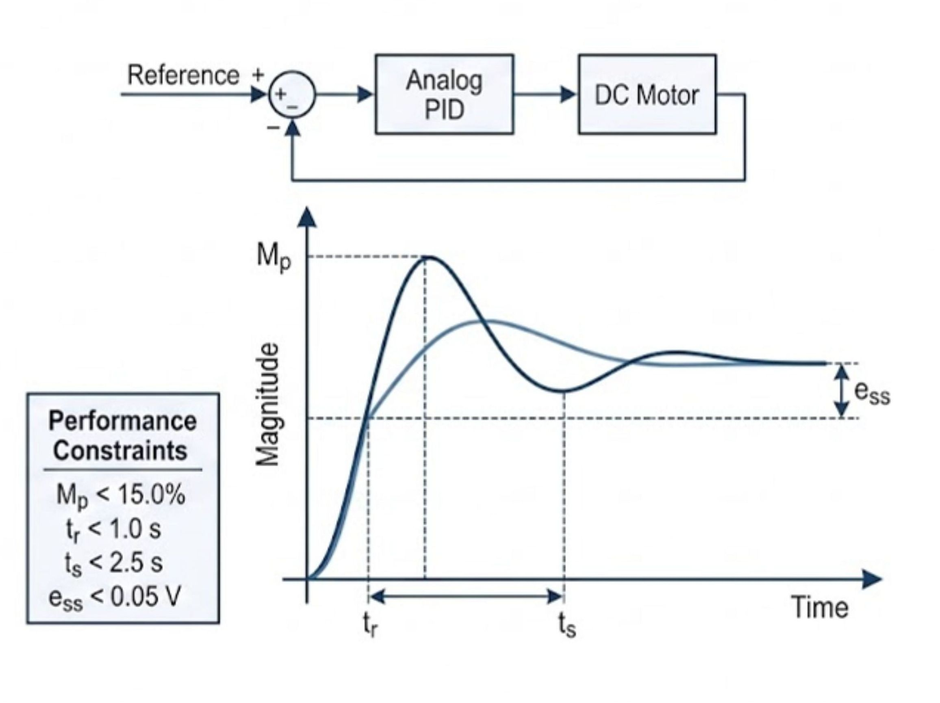
Project Scope & Electromechanical Specifications
System Performance Criteria:
Maximum Overshoot (Mp): Strictly < 15.0% for all step commands.
Rise Time (tr): Fast dynamic response with tr < 1.0 s.
Settling Time (ts): Damped transient reaching ±2% band within ts < 3 s.
Motor Parameters (Permanent Magnet DC Plant):
Armature Resistance (Ra): 2.0 Ω
Armature Inductance (La): 20.0 mH
Torque Constant (Kt): 0.05 N·m/A
Back-EMF Constant (Kb): 0.05 V·s/rad
Rotor Inertia (J): 0.01 kg·m²
Viscous Damping (B): 0.01 N·m·s/rad
3.0 s

Slide 4
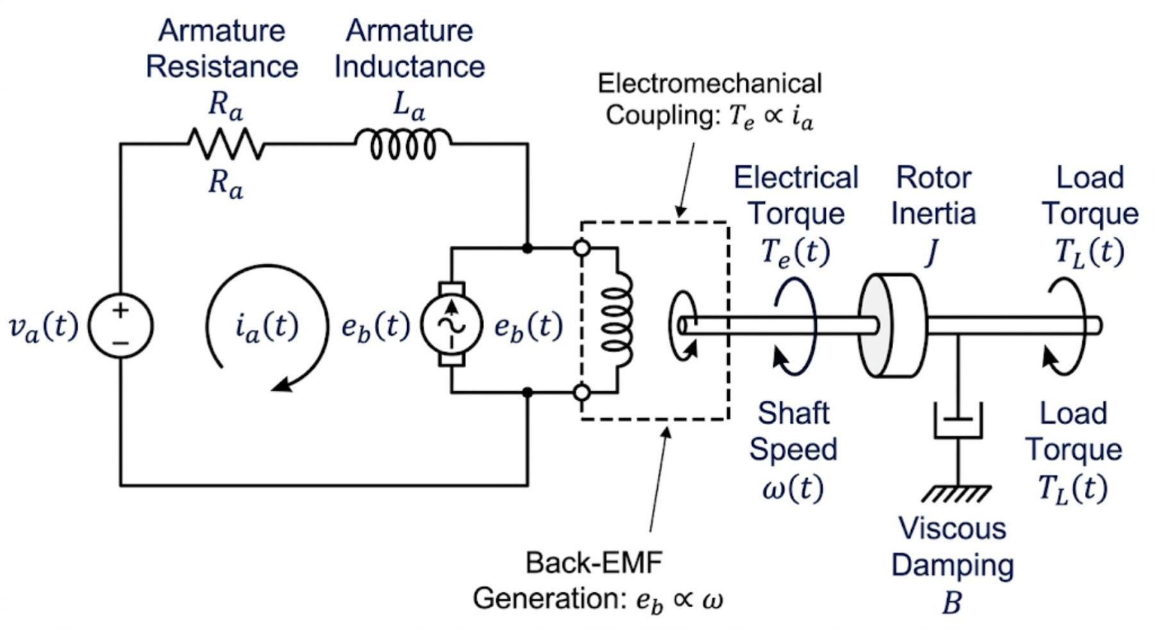
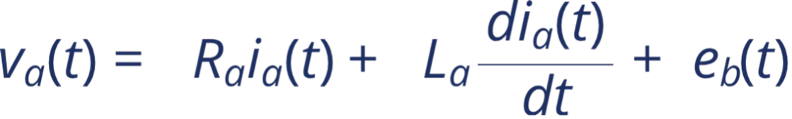
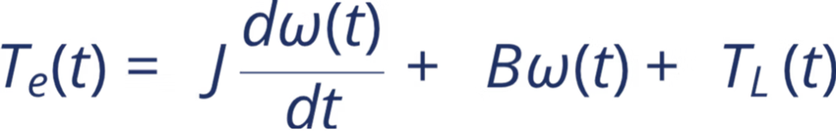


Plant Modeling: The DC Motor Equivalent
Differential Equations Governing the Electromechanical System
Electrical Subsystem (Armature):
Mechanical Subsystem (Rotor):
Coupled Dynamics: Injected armature current generates torque ( ), accelerating the rotor. The rotating shaft produces opposing back-EMF, naturally limiting maximum speed.

Slide 5
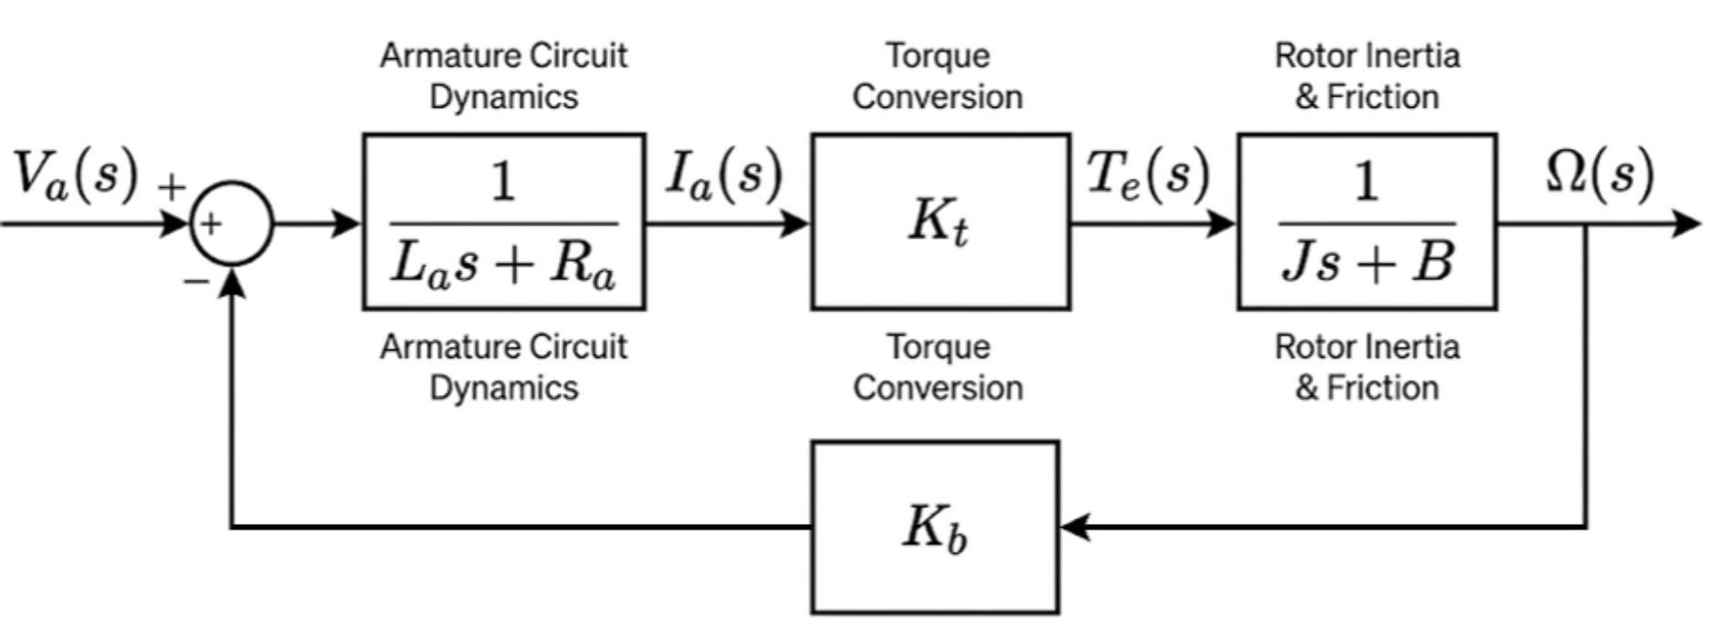





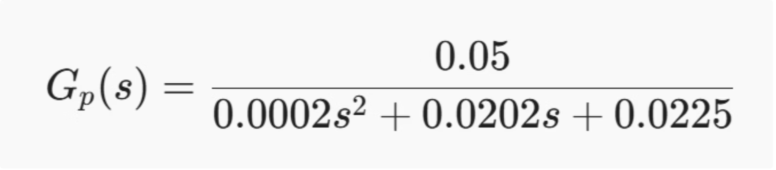
System Transfer Function & Parameters
Laplace-Domain Plant Model for Simulation
Combined Plant Transfer Function:
DC motor Parameters:
Resistance ( ): 2 Ohm Inductance ( ): 20.0 mH
Torque Cons ( ): 0.05 | Back-EMF Const. (Kb):0.05
Rotor Inertia ( J): | Viscous Friction ( ):
Numerical Characteristic Polynomial:

Slide 6





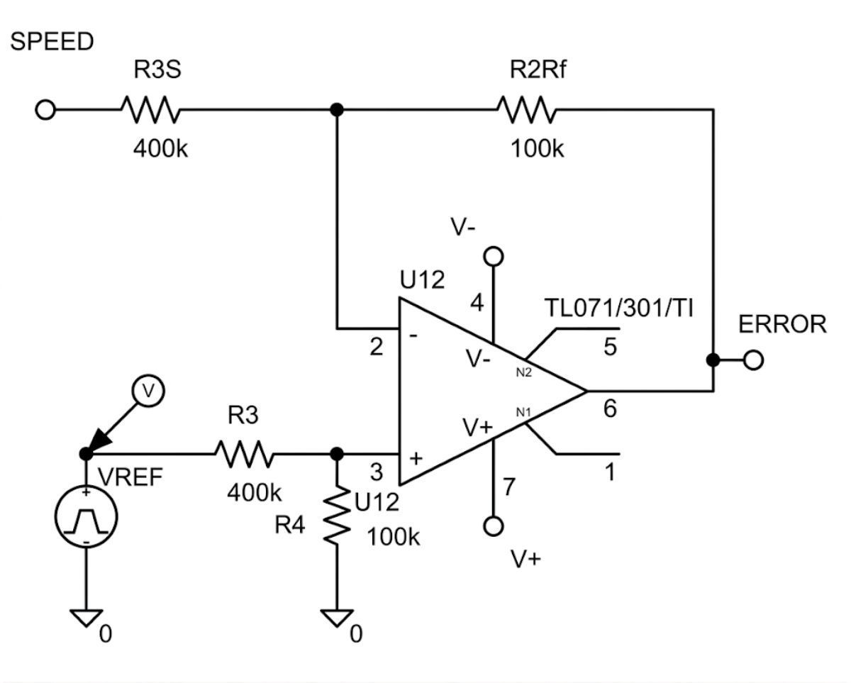
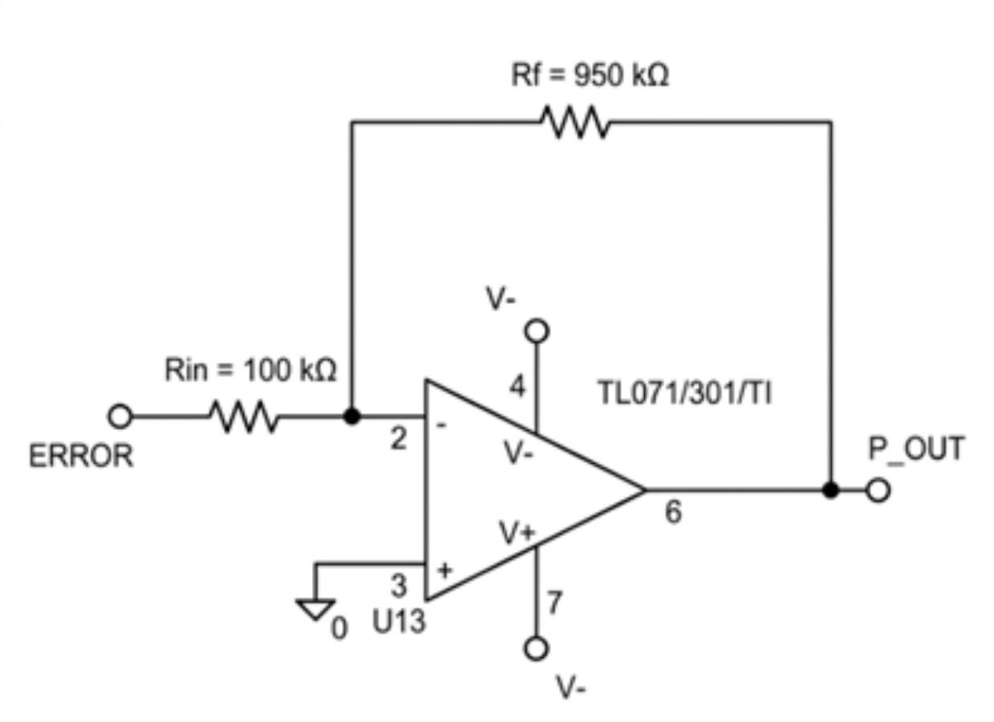

Analog Circuit Design: Error & Proportional Stages
Implementing Subtraction and Proportional Gain via Op-Amps
Error Subtractor Stage:
Proportional Gain Stage ( ):
A differential amplifier topology computes .
Inverting amplifier topology with .
Uses matched resistors to ensure high Common Mode Rejection Ratio (CMRR).
Hardware Tuning: Feedback resistor finalized at
Yields a calibrated stage gain of .

Slide 7





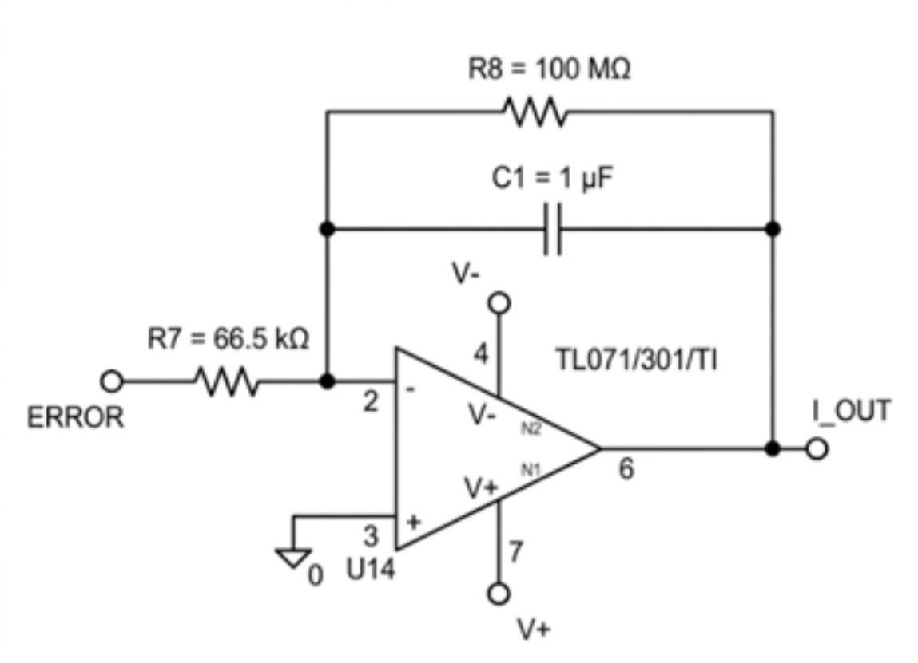
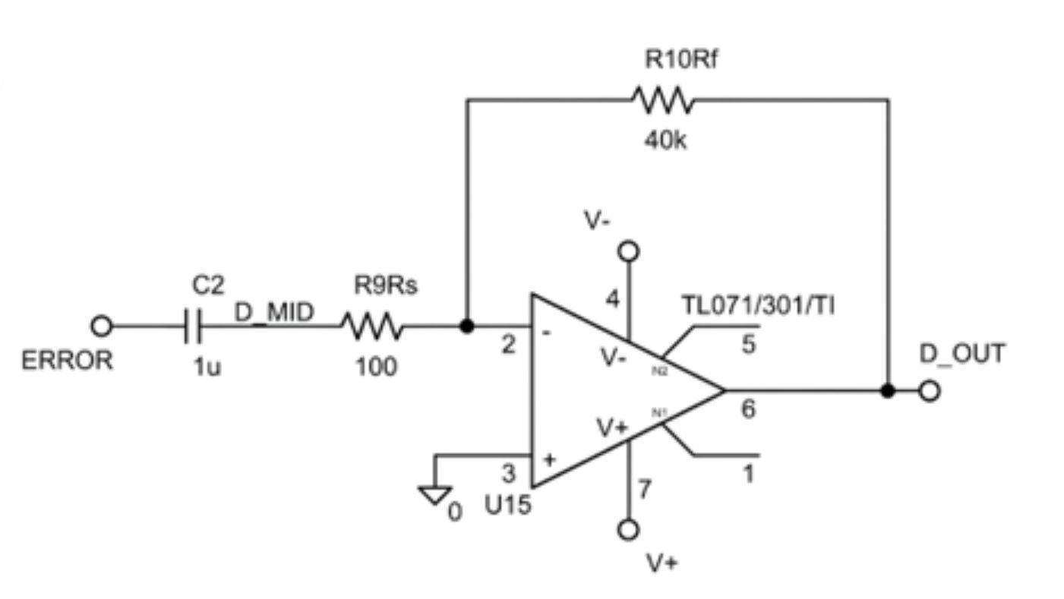
Analog Circuit Design: Integral & Derivative Stages
Realizing Continuous Integration and Active Damping
Integral Gain Stage ( ):
Derivative Gain Stage ( ):
Active Miller integrator holds accumulated charge to force steady-state error .
Damped differentiator limits high-frequency noise amplification from the tachometer.
Circuit components tuned to yield .
Hardware gain constant configured to for optimal phase lead.

Slide 8

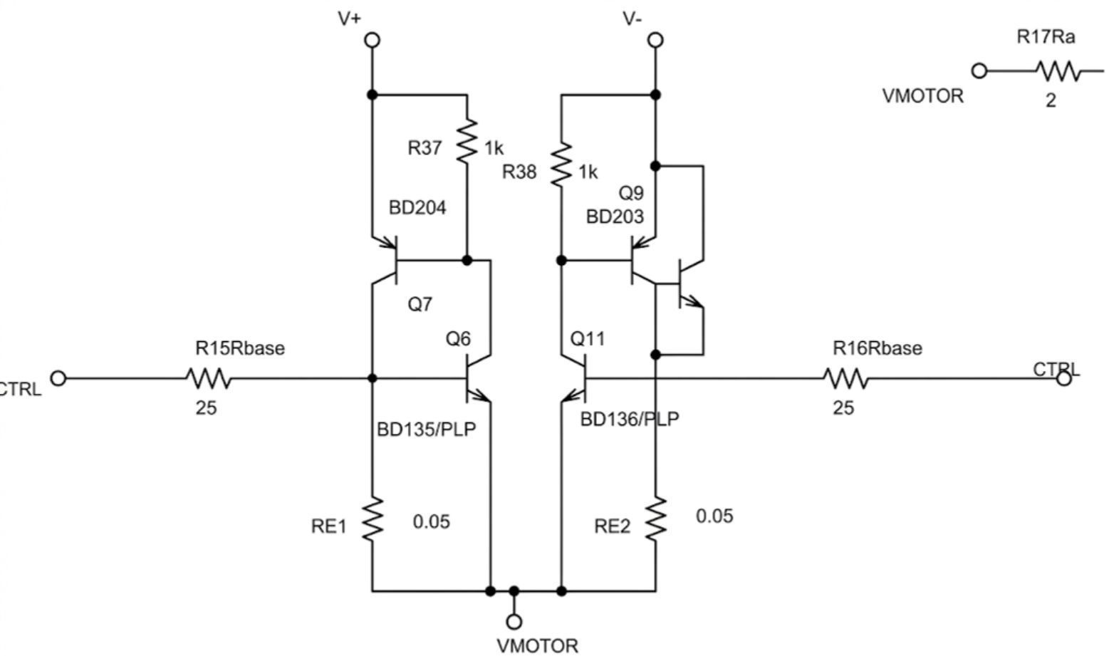

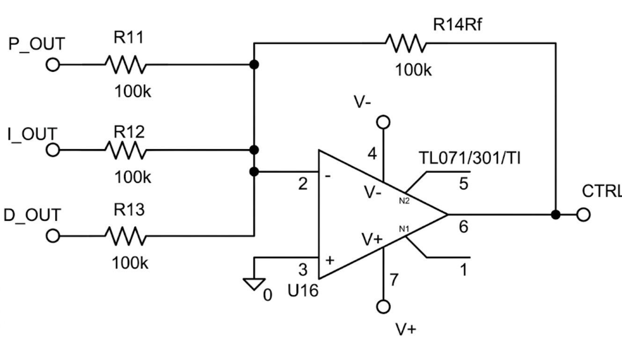
Analog Circuit Design: Summation & Power Drive
Combining Control Signals and Driving the Load
Summing & Inverting Stage:
Power Driver Stage:
A unity-gain inverting summer combines the parallel channels: .
High-current Push-Pull BJT/MOSFET bridge injects the required armature current into the motor plant based on the CO voltage.
A subsequent inverting buffer restores correct polarity to generate the final Controller Output ( ).

Slide 9
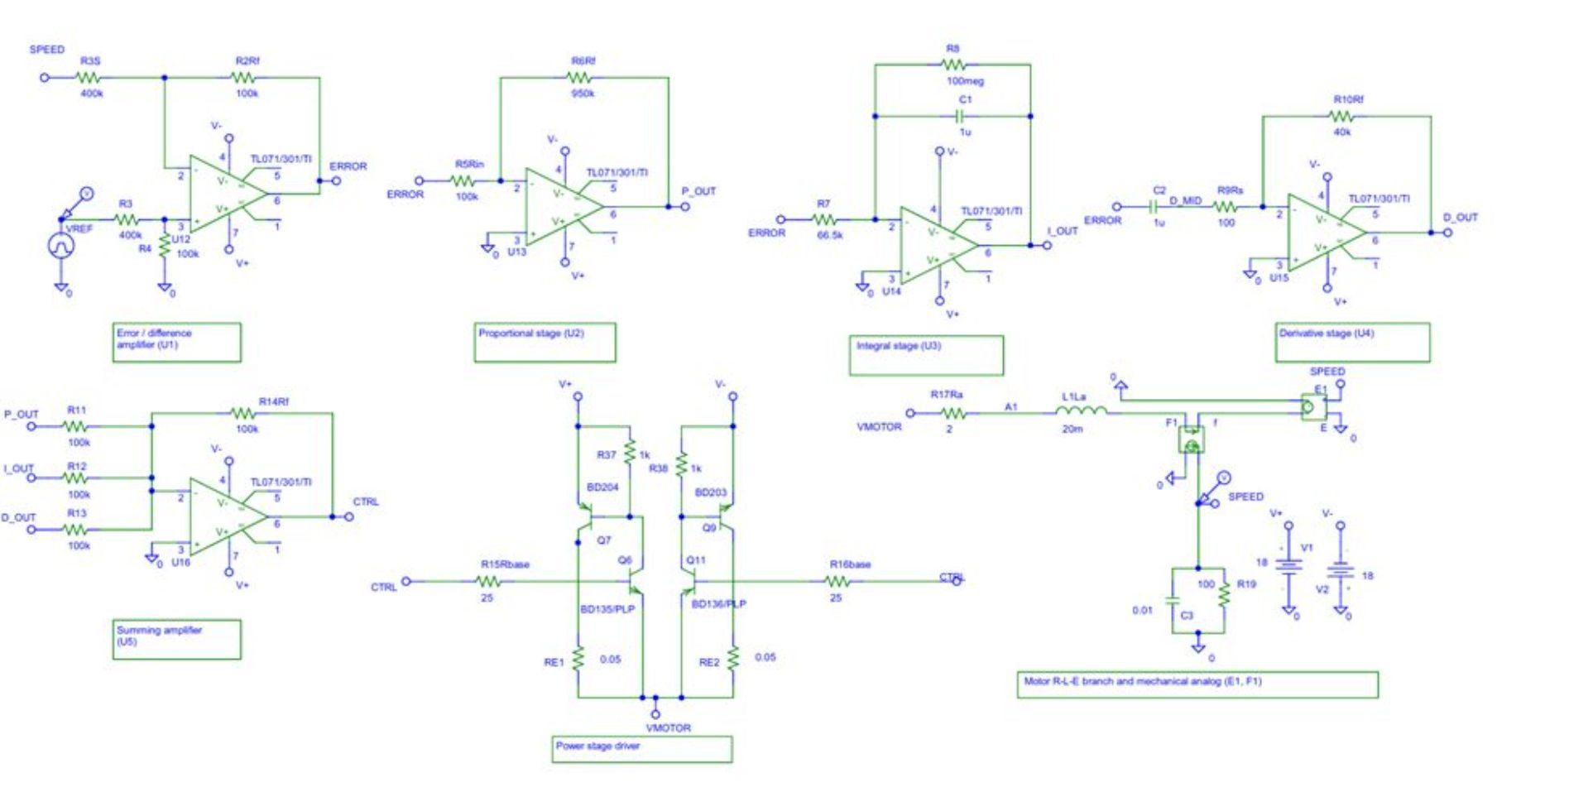
Complete OrCAD/PSpice 9.2 Architecture
Closed-loop model
Complete PSpice circuit
Reference input → Error amplifier → Analog PID → Power drive → DC motor → Speed feedback → error stage

Slide 10
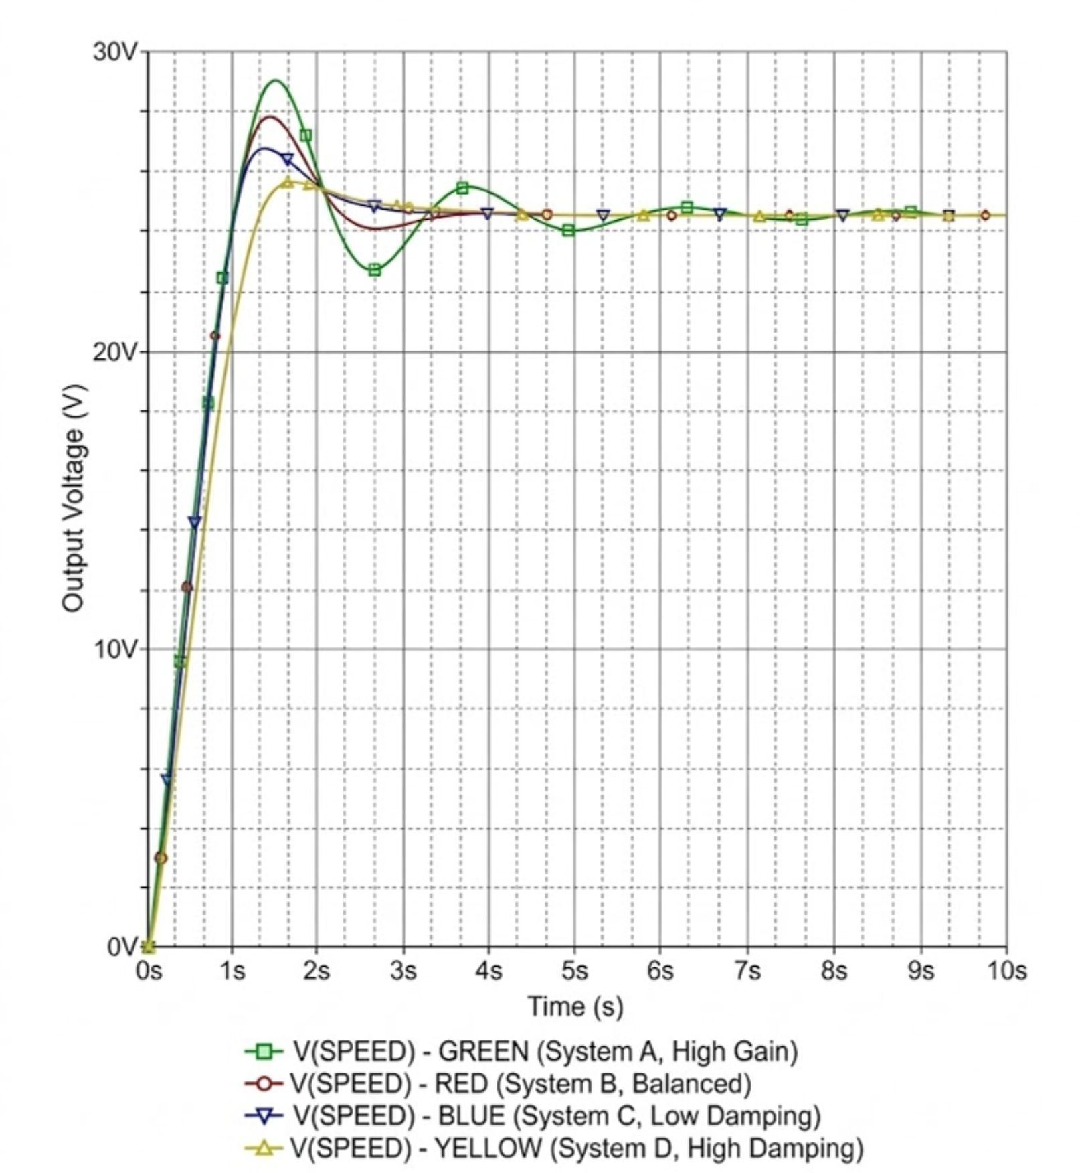




Hardware Optimization & Damping
Troubleshooting Overshoot in Worst-Case Transients
The Tuning Dilemma
Initial aggressive gains caused borderline overshoot on Test T8 ( step), failing the 15% constraint.
Hardware Parameter Adjustment
The proportional feedback resistor was locked at ( Rf=950 k Ohm ,Kp=9.5 ). This perfectly balanced proportional push with the derivative damping channel ( Kd = 0.04s ).
Verified Result
Test T8 peak speed finally dropped to 31.436 V , yielding a finalized Mp= 14.66%

Slide 11
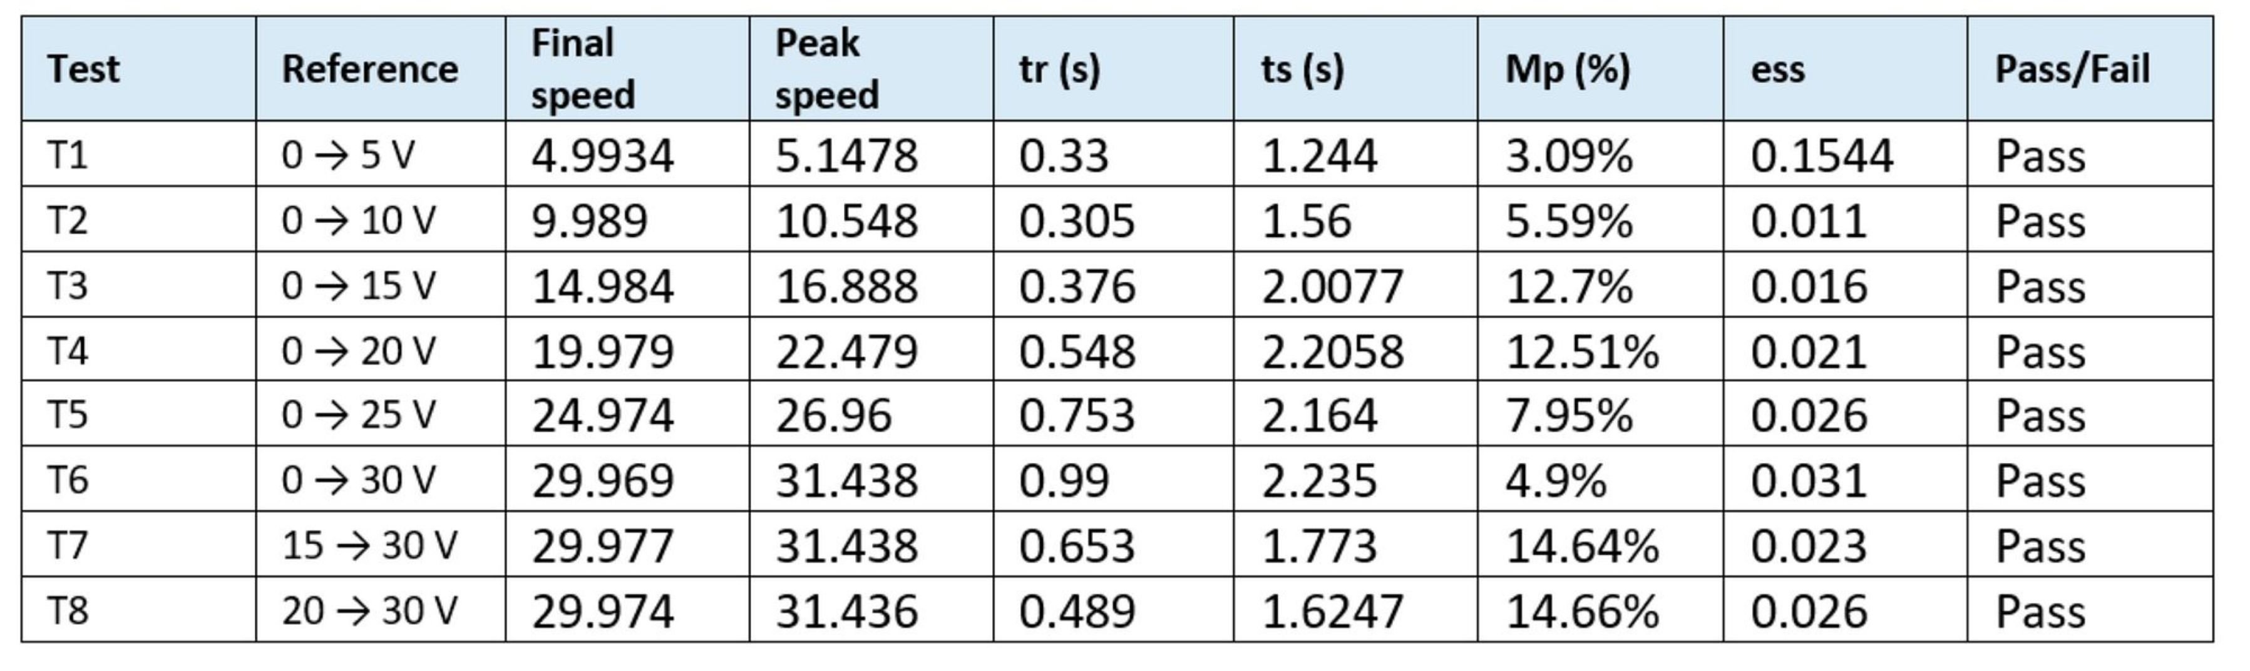



Experimental Performance Verification (Tests T1 – T8)
0.007

Slide 12
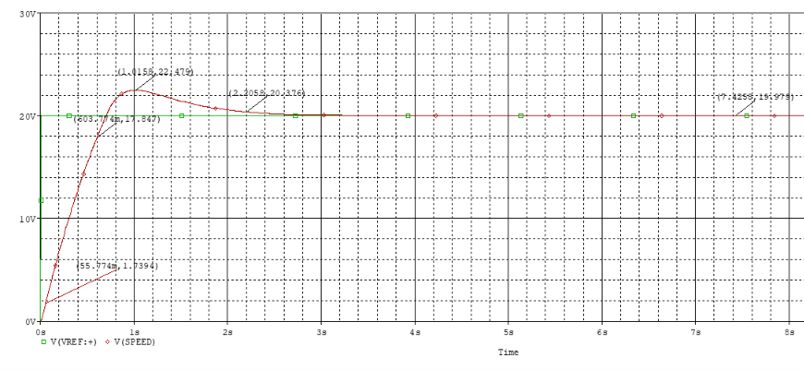
Analysis & Performance Validation
0 → 20 V Step Test · Verifying Design Against Strict Specifications
PERFORMANCE SPECIFICATIONS
Maximum Overshoot | Target: < 15% | Result: 12.51% | PASS ✓
Max Rise Time (tr) | Target: < 1 s | Result: 0.548 s | PASS ✓
Max Settling Time (ts) | Target: < 3 s | Result: 2.2058 s | PASS ✓
Max Steady-State Error | Target: Minimize | Result: 0.021 | PASS ✓
ALL SPECIFICATIONS MET ✓
Conclusion: For the 0 → 20 V test condition, the analog PID controller successfully regulates DC motor speed. The measured overshoot (12.51%), rise time (0.548 s), settling time (2.2058 s), and steady-state error (0.021) meet all strict performance specifications.

Slide 13


Load Disturbance Rejection Analysis
Evaluating Controller Robustness (Cases D1 – D4)
The Disturbance Test
Key Insight
A steady-state operating speed is established. At t= 10s, a sudden mechanical load (torque step) is applied to the motor shaft.
The active integral stage ( ) successfully forces the steady-state error back to baseline ( maximum) regardless of the load magnitude.
The controller must detect the sudden speed drop and inject additional armature current to reject the disturbance and recover the setpoint.
Maximum speed deviation scales linearly with the magnitude of the applied torque step.
Experimental Disturbance Data
Disturbance Case | Applied At | Load Condition | Maximum Deviation (V) | Recovery Time (s) | Final Error (V)
D1 | t = 10 s | 10% load change | 0.223 | 0 | 0.028
D2 | t = 10s | 20% load change | 0.456 | 0.519 | 0.026
D3 | t = 10s | 30% load change | 0.684 | 0.793 | 0.028
D4 | t = 10s | 40% load change | 0.913 | 0.982 | 0.030

Slide 14
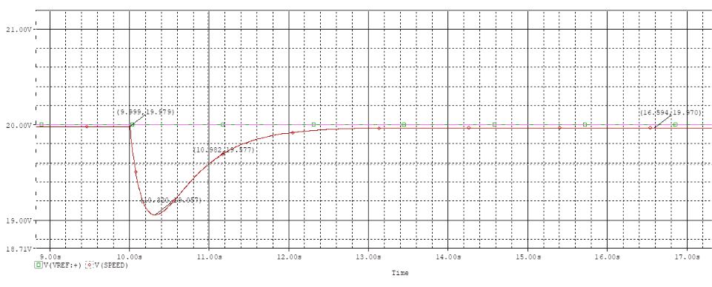
Dynamic Recovery Waveforms (D1 – D4)
Visualizing Speed Sag and Integral Compensation
Waveform Analysis
The waveforms demonstrate the immediate voltage sag (speed drop) precisely at t=10s .
The smooth, monotonic recovery curves prove the system remains critically damped even under sudden heavy loading, with zero secondary oscillations during recovery.
Even under the severe 40% load step (D4), the controller fully recovers within 0.982s .
Recovery Waveform (40% of nominal load)

Slide 15
Course Outcome Mapping — EEE 208(S)
Alignment with Program Outcomes and Assessment
CO | PO | Outcome Description | Project Execution & Evidence
CO1 | PO(e) | Use modern tools to solve problems relevant to electronic circuits | Used PSpice for all simulations. Implemented transient analysis, parametric sweep and probe measurements.
CO2 | PO(d) | Compare theoretical and experimental results of electronic circuits | Derived TF mathematically (pole-placement), predicted OS/tr/ts from formulas, then verified each in PSpice.
CO3 | PO(c) | Design electronic circuits so that specific performance characteristics are attained | Designed the full closed-loop PID to meet three simultaneous specs (OS<15%, tr<1s, ts<3s). Chose component values from mathematical derivation. All specs met in final simulation.
CO4 | PO(j) | Demonstrate and present designed electronic circuits/systems | Full presentation with circuit schematic, waveforms, systematic tuning table, and three advanced demonstrations (noise, anti-windup, disturbance).
CO5 | PO(i) | Demonstrate effective individual and team-working skills | Project divided between two members.

Slide 16



Limitations & Future Work
Practical Constraints and Next Steps for Hardware Realization
Limitations
Future Work
PSpice does not capture every real motor non-linearity or parameter variation.
Op-amp bandwidth, slew rate and offset can alter practical response.
Transistor SOA, thermal behavior and crossover effects require hardware validation.
Build the controller with a physical DC motor and speed sensor.
Include realistic load, sensing and non-linear motor effects.
Perform tolerance, temperature and supply-variation tests.
Refine the power stage and tune performance over the chosen operating range.
Component tolerances shift the realized , and .

Slide 17


References
Foundational Texts and Technical Documentation
Control Systems Engineering
Cadence OrCAD / PSpice 9.2
Operational-Amplifier Documentation
Nise, N. S., Control Systems Engineering — PID design and transient-response analysis.
Cadence OrCAD / PSpice 9.2 — schematic capture and transient simulation.
Operational-amplifier datasheet / model documentation used in the simulation.
Transistor Datasheets
Project Proposal
BD135, BD136, BD203 and BD204 transistor datasheets / simulation models.
Project Proposal: "Design and Simulation of an Analog PID Controller for DC Motor Speed Regulation", EEE 208(S).

Slide 18
Thank You
Questions ???

